Slide 1
ISIS Biosafety and Regulations brief – as an outcome of ISIS SHE code 16 (biosafety) audit
Ludmila Mee, ISIS BioLabs Manager
IDG
3rd October 2024

Slide 2
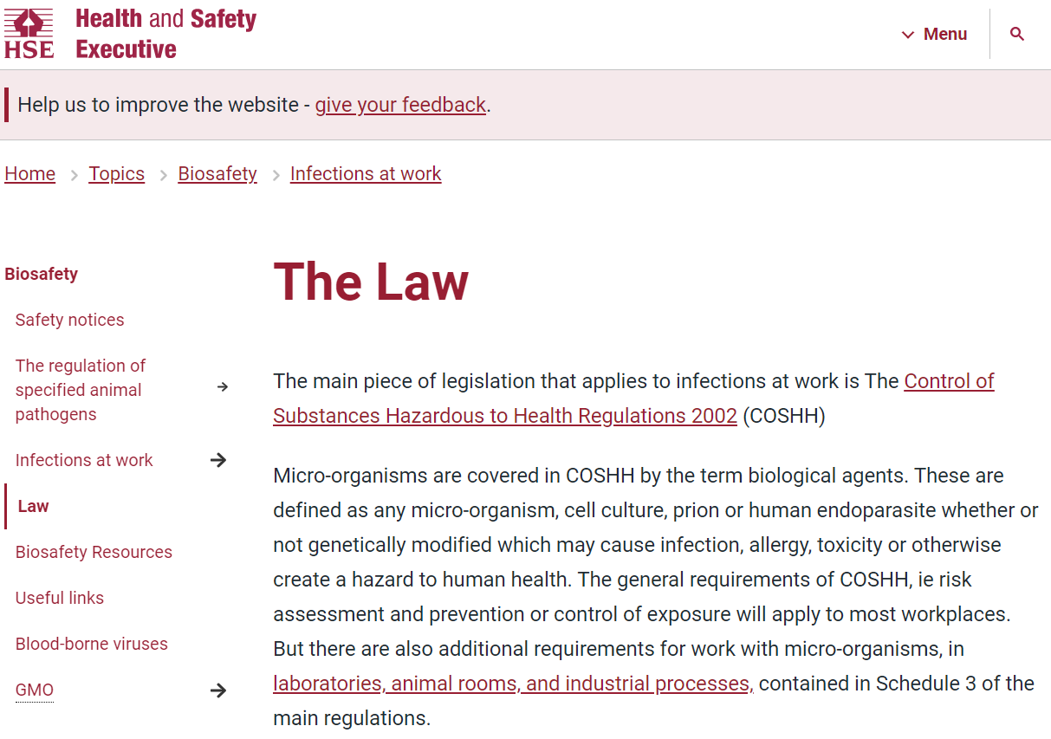
ISIS Biological Samples
“BioSample pipeline for neutron beamline”
Specifics
Biological incompatibility (for example bacteria and phages)
Biosafety (with no minimum exposure limit)
Regulations and legislations (ethics, HTA, import/export, etc)
Variety
Lipid nanoparticles
Proteins (in solutions, dried, crystals)
RNA/DNA
Lipids
Cells
Viruses
Tissues (animal and human)
Animal by-products (milk, skin, etc)
…and anything interacting with above

Slide 3
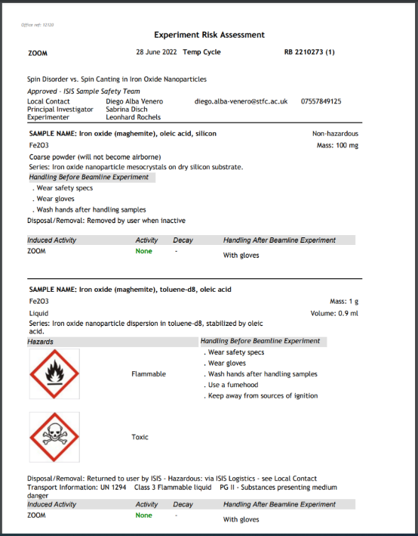
How to demonstrate the safety and legal compliance of your bio-experiment at ISIS?
ISIS ERA
Every Bio-ERA must be accompanied by a completed and signed off BioCOSHH RA!
ERA DOES NOT ASSESS BIOSAFETY or advise on Biosample IMPORT/EXPORT REGs!

Slide 4
BioCOSHH Risk Assessment: 10-page document
Risk Assessing your bio-experiment: it is all about due diligence
Give us the details – organism(s), its origin, how well it is characterised, what will be done to it, how to deal with spillages, waste, etc, etc
The outcome: classification of experiment or unclassified, assigning appropriate containment level, and ensuring compliance with law (import/export regs) = Your bio-experiment is properly supported
I hold a Biosafety Practitioner Level 1 certification: 6-weeks Foundation Course provided by Biosafety Training Institute at Edinburgh
I represent ISIS at RAL GMSMC (Biosafety) committee

Slide 5
ISIS BioSample timelines
BioSample = DNA, RNA, protein, live cells, viruses, plants, genetically modified organisms and anything derived from human/animal/plants and their tissues and fluids
Live Organisms (anything that can self replicate, including but not limited to phages, viruses, live cells, plants, animals, etc) and seeds/spores | Genetically Modified Material (whether animals, plants, cells, seeds, spores or tissues) | Human Tissue /body parts/ samples derived from a human – whether freshly obtained or fixed/stored (such as bodily fluids, hair, nail clippings, etc) | Human participants /Clinical trial data/”DNA theft” | DNA, RNA, protein, nanoparticles (or any material compatible with live organisms) | Animal by-products such as milk, hides, bones, honey, etc, or plants/seeds
Biohazard risk assessment | GMO risk assessment | UK Research Ethics Committee (UK REC) approval for experiment and tissue storage | UK Research Ethics Committee (UK REC) approval | Assessment of sample cross-compatibility in multi-user lab might be required | Animal & Plant Health Agency import licence might be required
BioCOSHH RA | BioCOSHH RA | IRAS application | IRAS application | Internal assessment | APHA application
Up to 4-6 weeks | Up to 6-8 weeks | Up to 2-3 months | Up to 3-5 months | Up to 1-2 weeks | Up to 2 weeks
Please note that any infectious/ potentially infectious substances and import/export of or work with live animals (whether lion, caterpillar or Trypanosome) and plants require a special consideration or, even, a licence. Speak to BioLab manager.

Slide 6
THE TAKE-HOME MESSAGE(S)
Talk to me in advance of your bio-experiment!
Ludmila.Mee@stfc.ac.uk
Tel: +44(0) 1235 446490
Mobile: 07749401114
If I am learning about new bio-experiment from ERA it is often too late for putting appropriate processes in place = poor due diligence…

