Slide 1
ISIS Neutron and Muon Source
Neutrons and muons to advance knowledge and improve lives

Slide 2

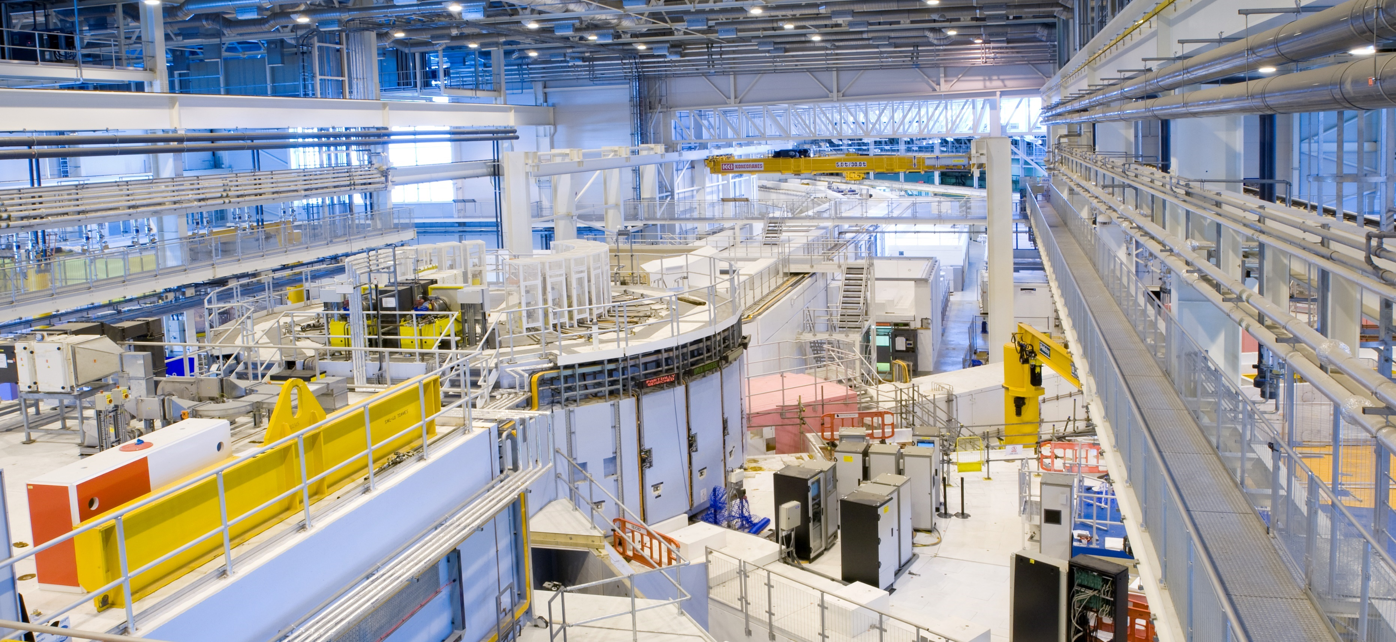
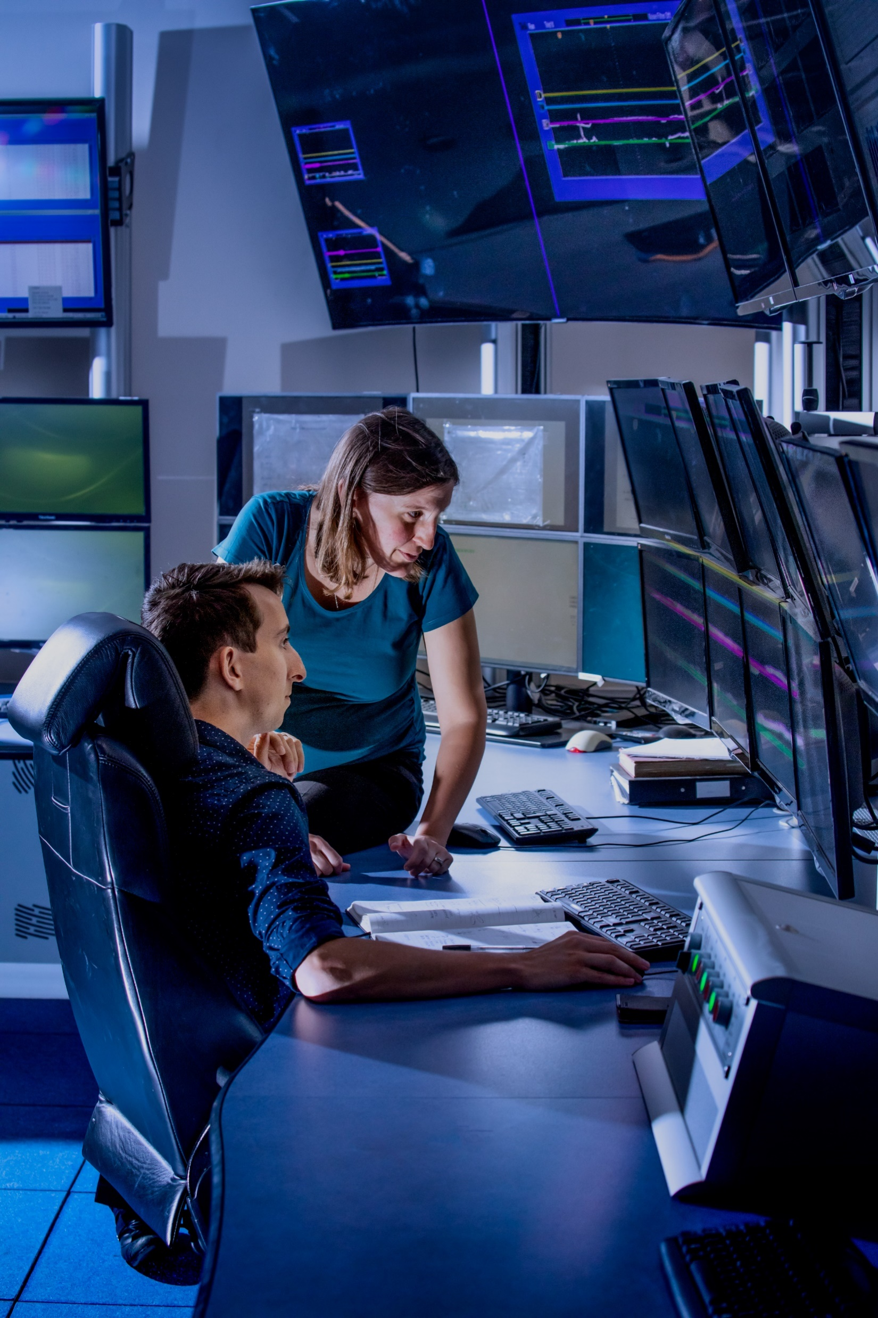
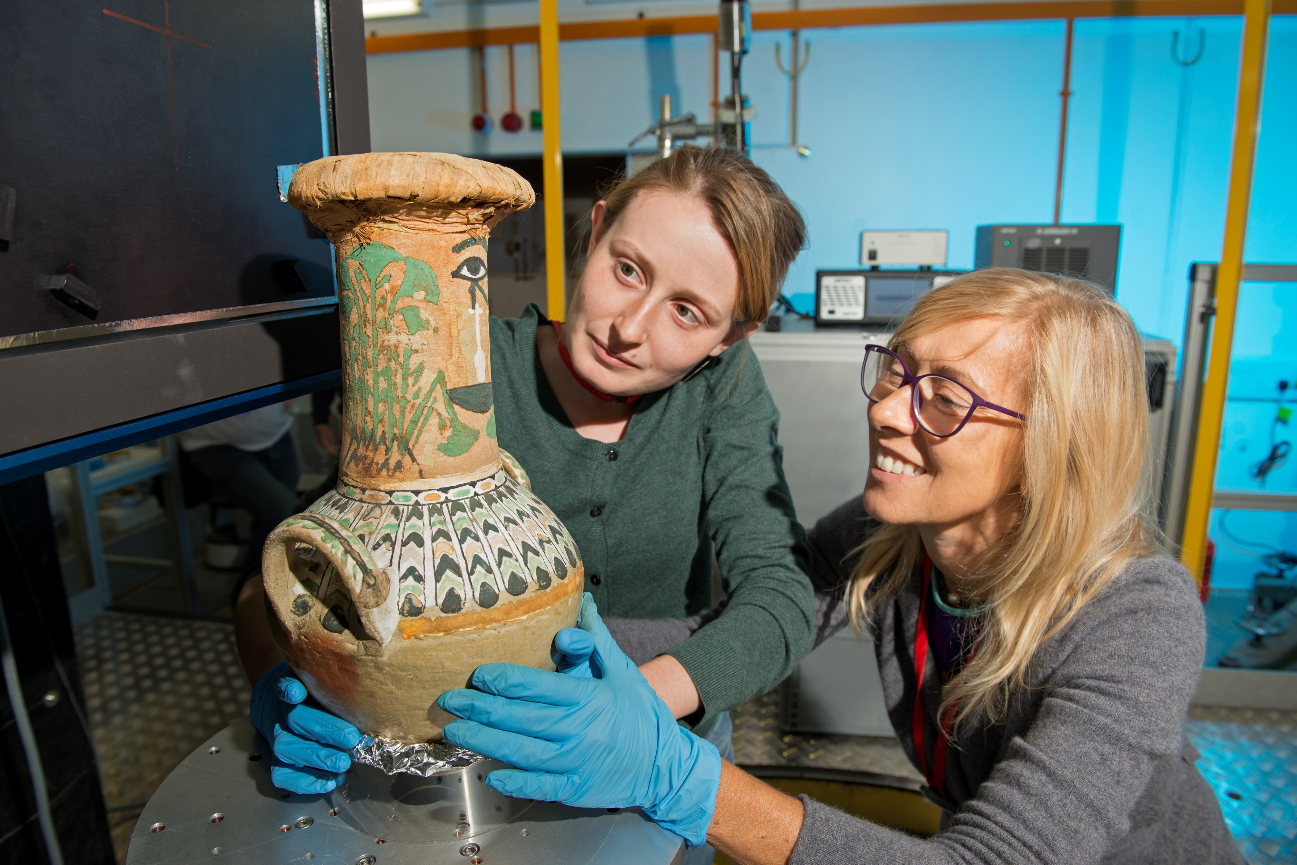
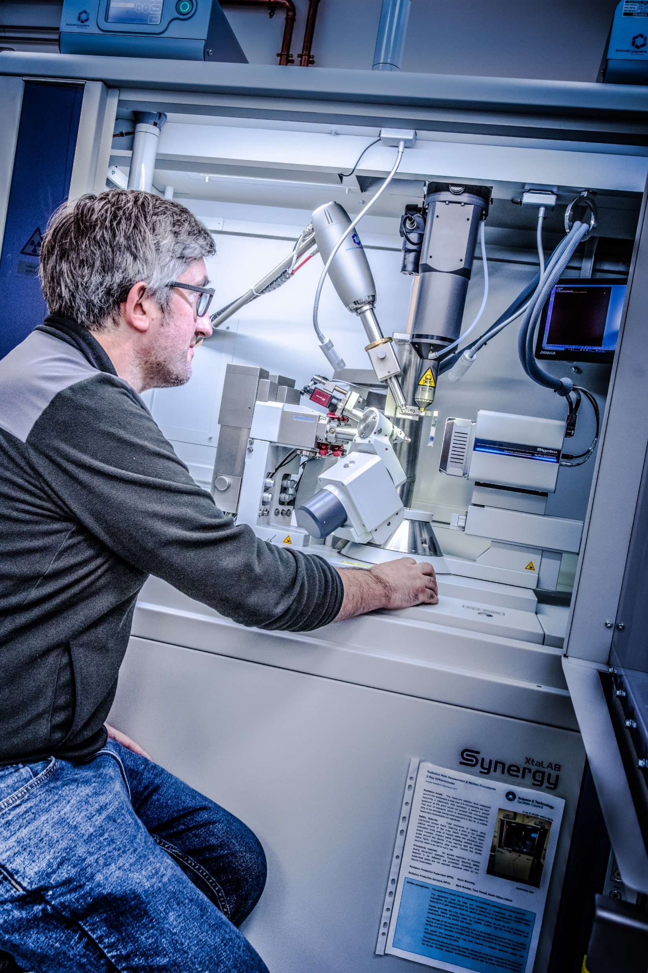
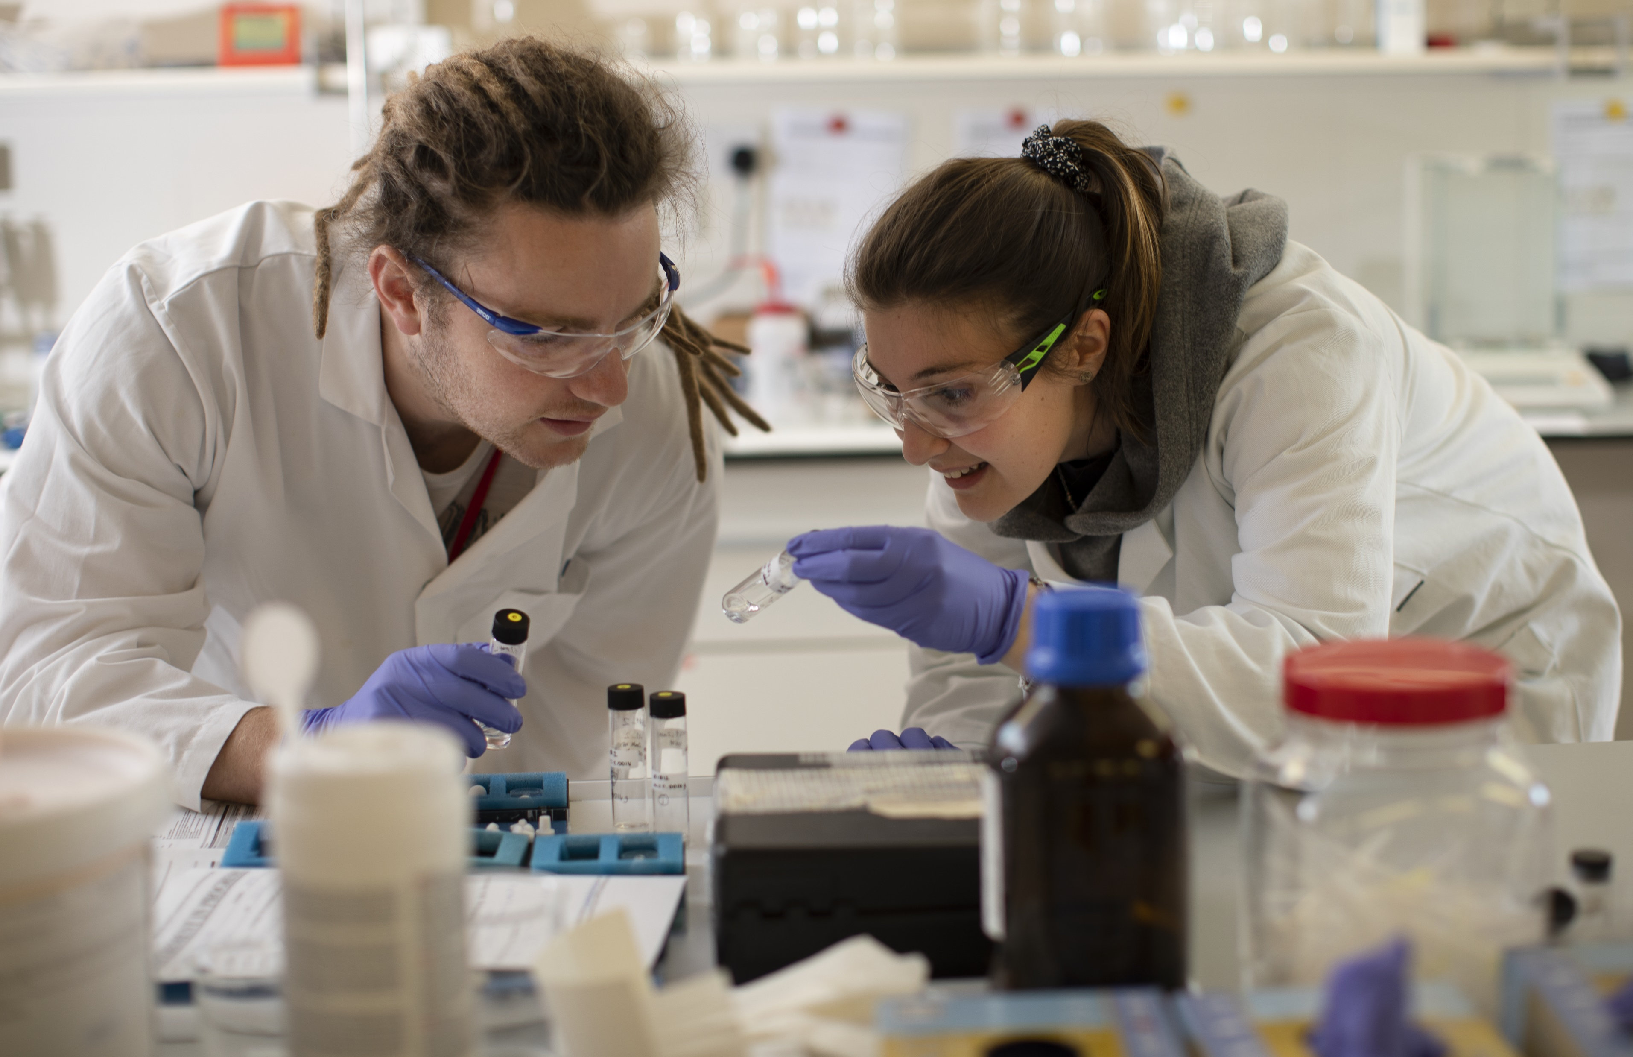
What is the ISIS Neutron and Muon Source?
The ISIS Neutron and Muon Source is a world-leading research facility for physical and life sciences based at the STFC Rutherford Appleton Laboratory in Oxfordshire.
The suite of instruments at ISIS enables scientists to study the properties of materials at the atomic and molecular level.
By harnessing the power of neutron and muon techniques, researchers can explore a vast range of scientific fields, from physics and chemistry to biology and engineering, helping to push the boundaries of knowledge and drive innovation.

Slide 3






What is the ISIS Neutron and Muon Source?
ISIS’s mission is to enable research that advances knowledge and improves lives.
Annually, ISIS hosts around 3000 UK and international researchers from academia and industry. The research conducted at ISIS plays an important role in addressing global challenges, answering fundamental questions, and delivering scientific and socioeconomic impact.
^{A typical year at ISIS…}
>35
instruments
hosting
1200 experiments
enabled by
600 staff
for…
3000
users
from
30
countries
generating
600
publications

Slide 4
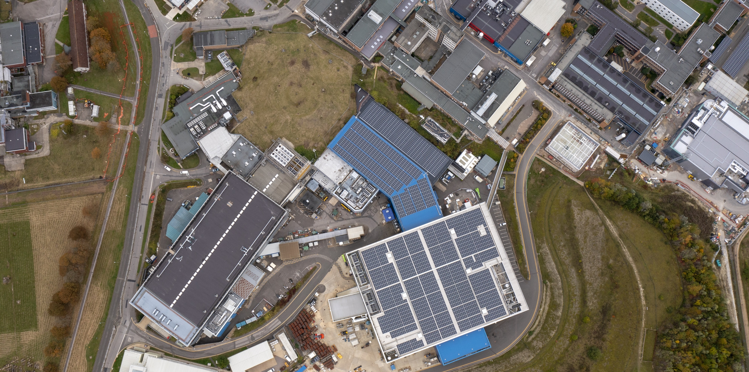
What does the ISIS Neutron and Muon Source do?
ISIS accelerates protons and collides them into targets to generate neutrons and muons.

Slide 5
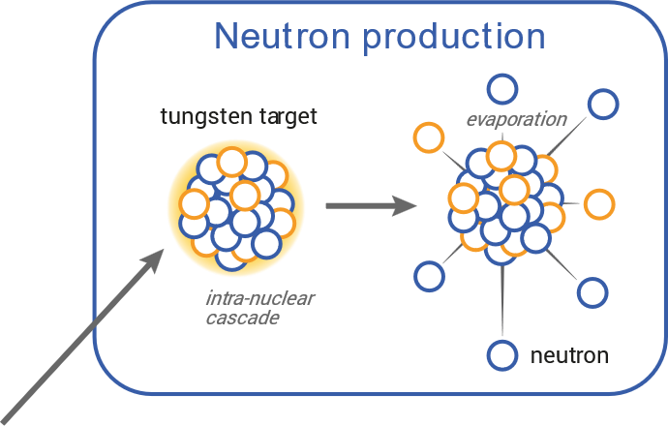
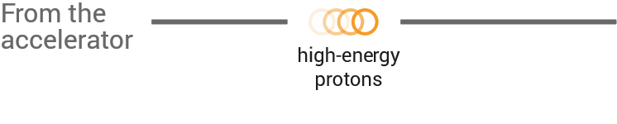
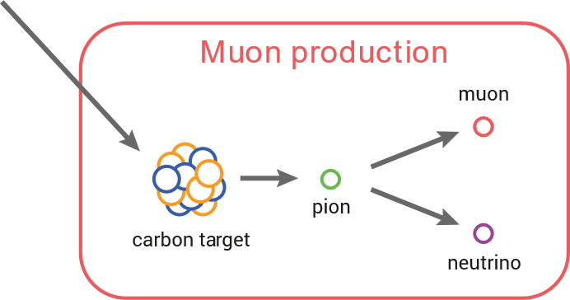
What does the ISIS Neutron and Muon Source do?
ISIS accelerates protons and collides them into targets to generate neutrons and muons.
At the heart of ISIS is an 800 MeV accelerator that produces intense pulses of protons 50 times a second. These pulses are fired at two tungsten targets and the process of spallation produces neutrons that fly off in all directions.
Muons are produced upstream of one of the neutron targets when the proton beam passes through a carbon plate producing pions, which rapidly decay into muons.

Slide 6
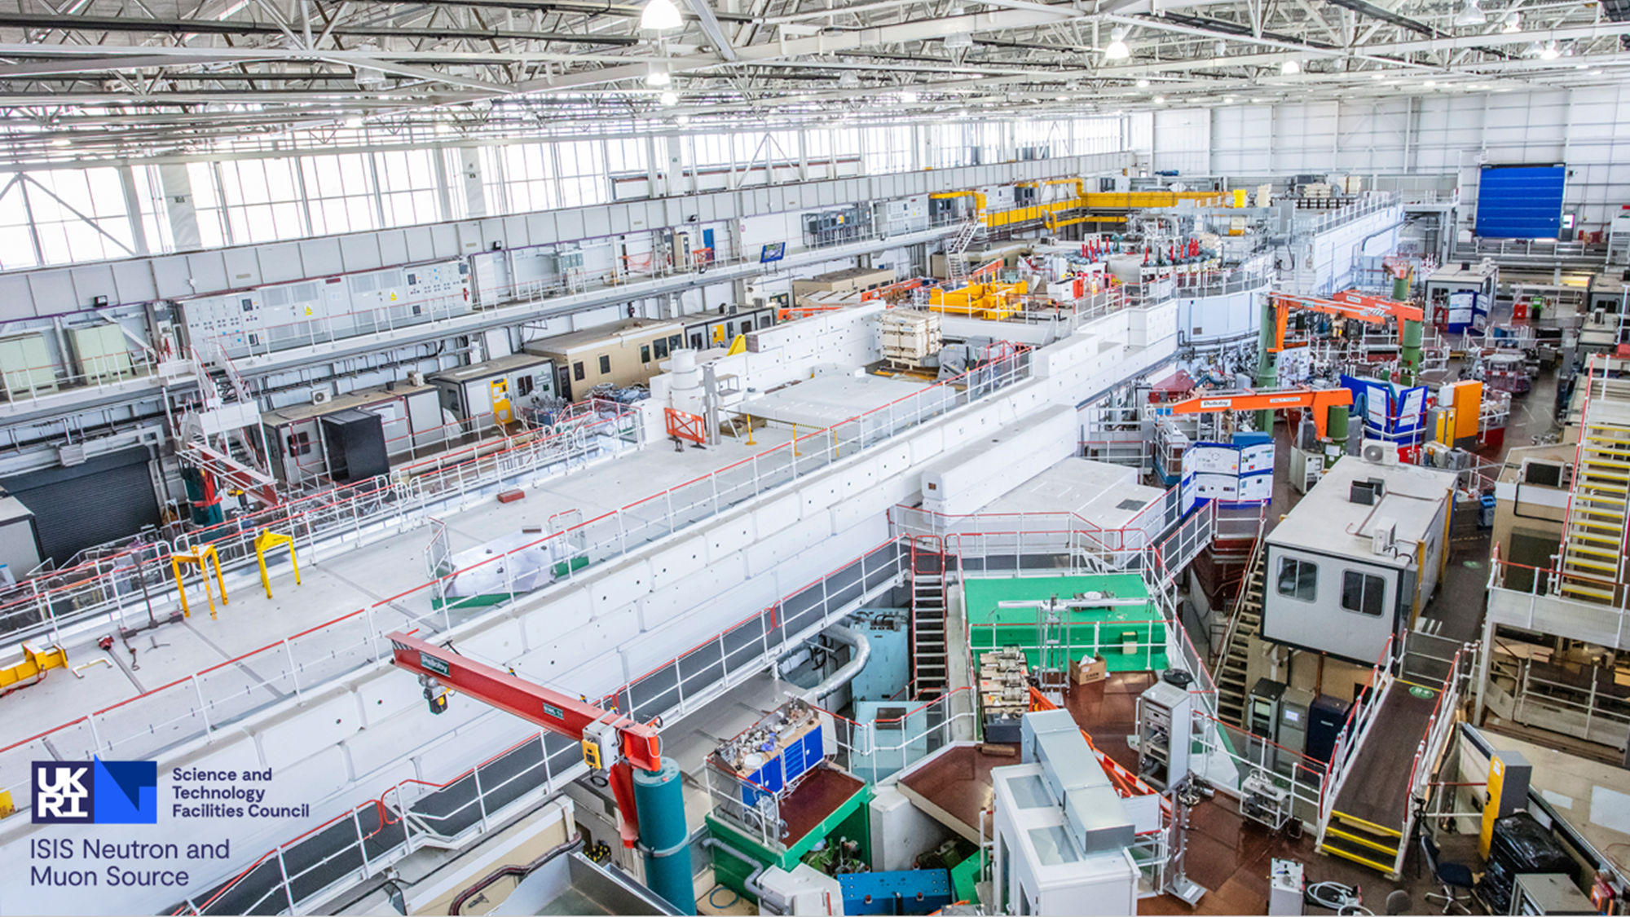
Inside Target Station 1

Slide 7
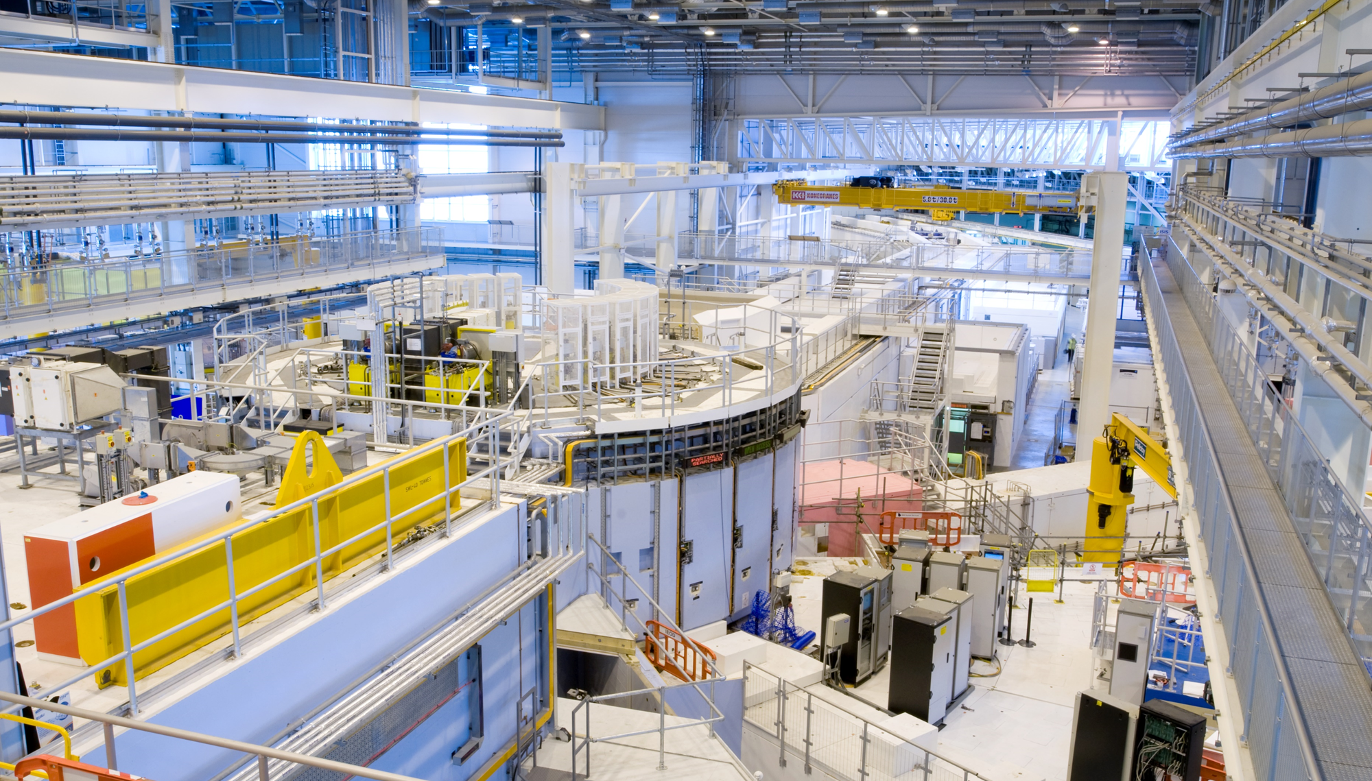
Inside Target Station 2

Slide 8
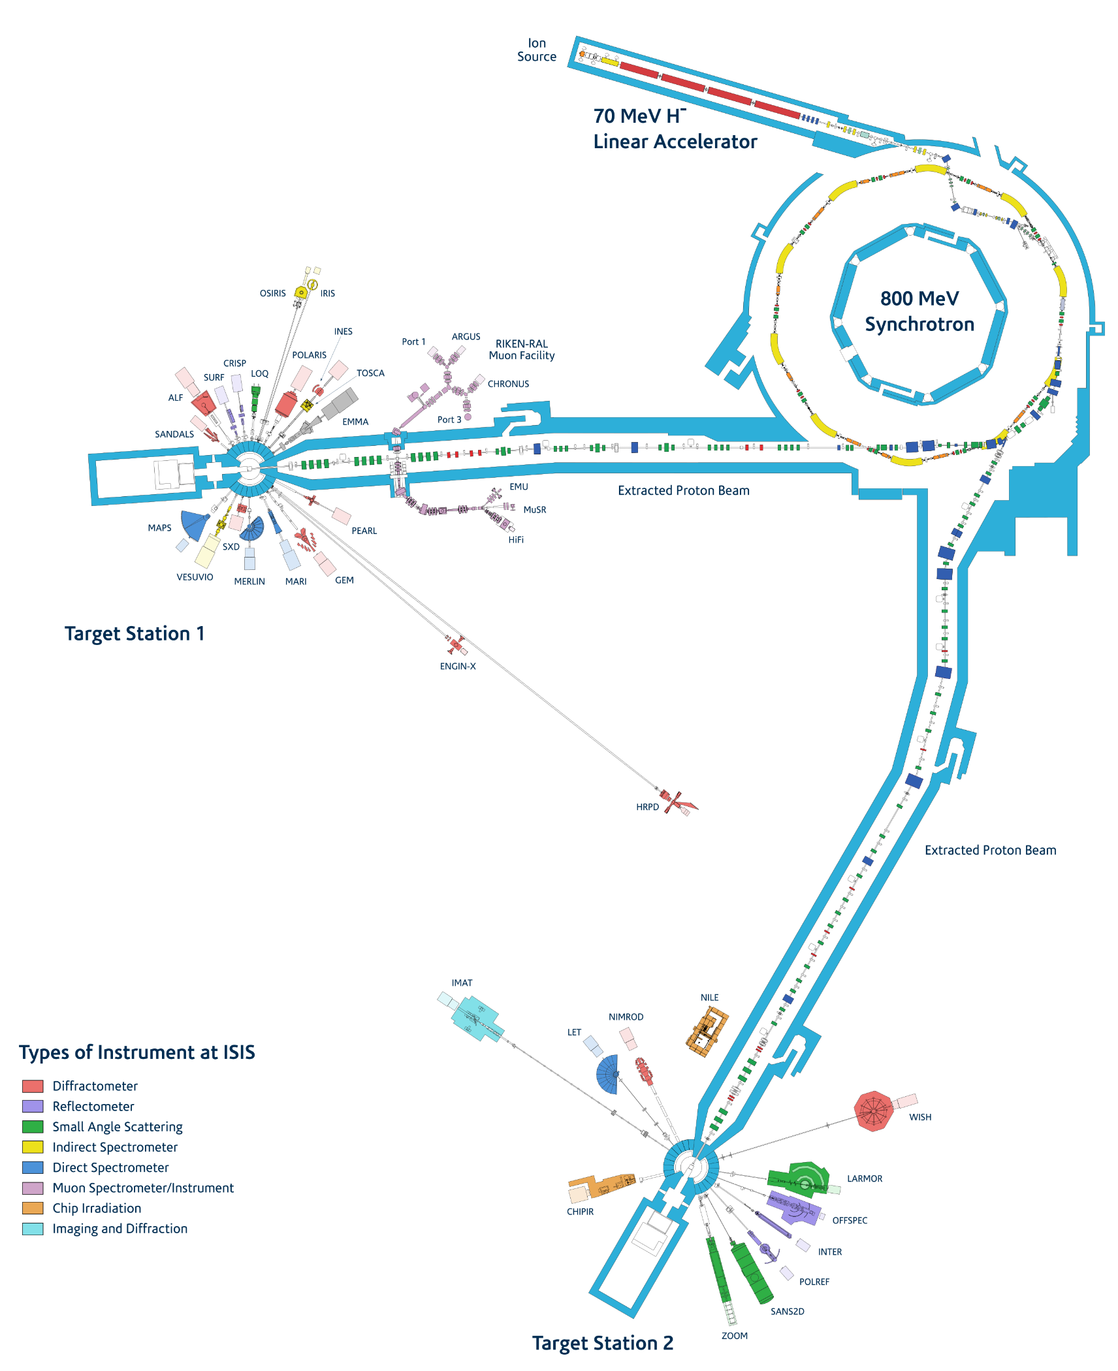
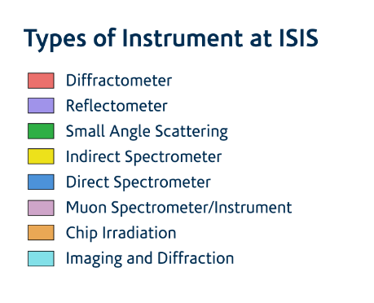
What does the ISIS Neutron and Muon Source do?
ISIS accelerates protons and collides them into targets to generate neutrons and muons.
The neutrons and muons generated at ISIS are directed to over 35 specialised instruments, distributed across two target stations.
The ISIS instrument suite supports a wide range of research using neutrons and muons as probes. Each instrument is tailored to investigate different phenomena and properties of matter.

Slide 9
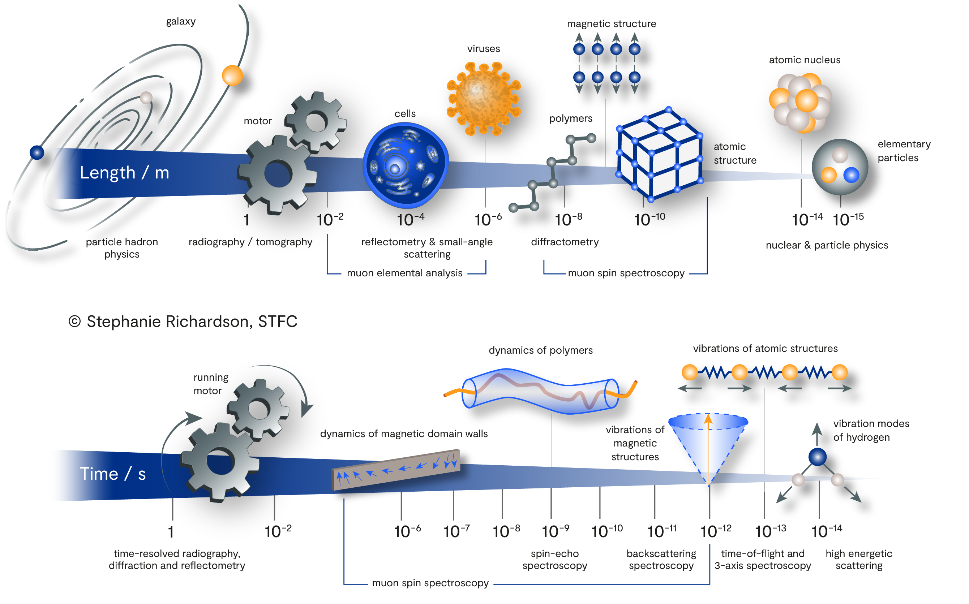
Why use neutrons and muons to study materials?
Addressing global challenges and making technological advances relies on a detailed understanding
of material properties.
Neutrons and muons can be used in many ways to study interactions that occur at different rates, and structures that range from the everyday to the atomic scale.

Slide 10
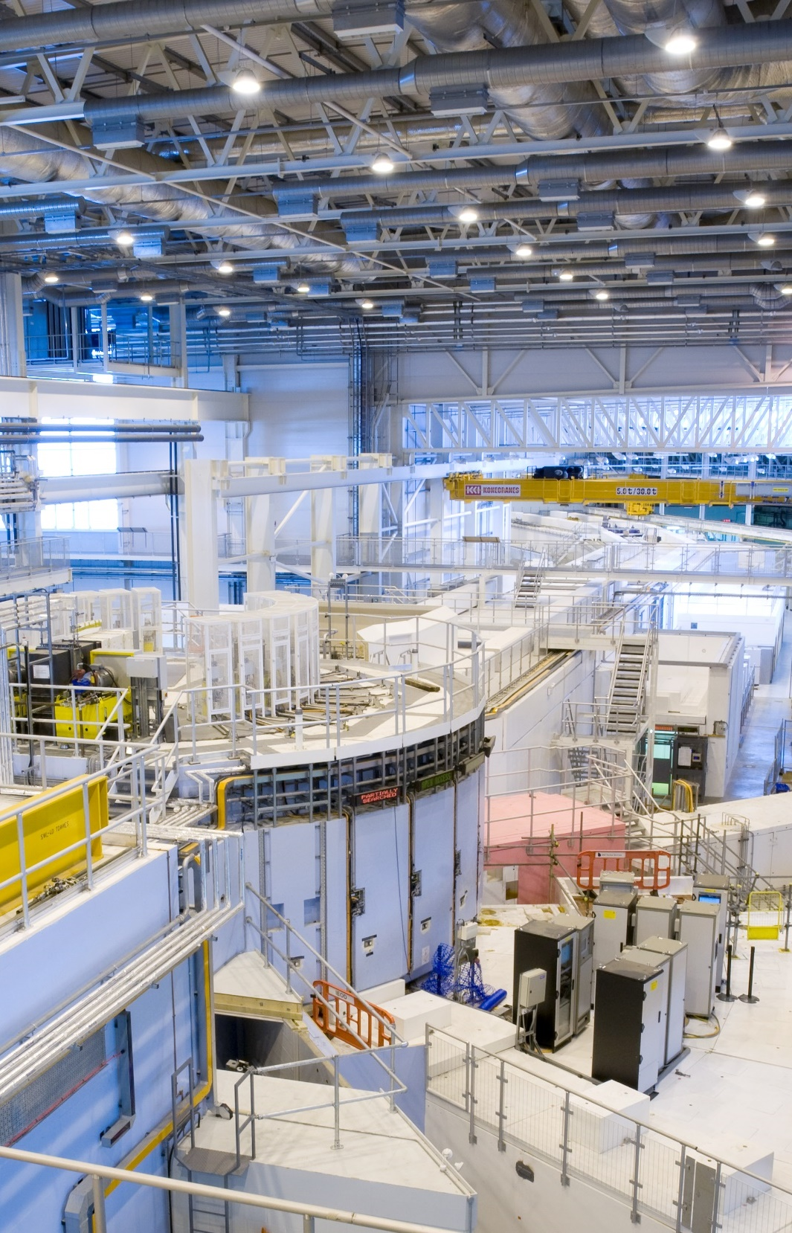
Why use neutrons to study materials?
Neutrons can be used in materials characterisation to:
Study structure
Neutron wavelengths are comparable to the spacings of atoms and molecules.
Study dynamics
Neutron energies are comparable to the time scales of molecular diffusion, vibrations and rotations.
Study magnetism
The neutron’s magnetic moment can be used to study the microscopic magnetic properties of materials.

Slide 11
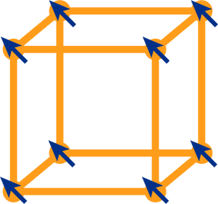


Why use muons to study materials?
Muons are short-lived elementary particles that can be used in materials characterisation to:
Study the ordering of electrons
neutrinos
Magnets, semiconductors and superconductors are probed using the magnetic fields inside the materials.
positive muon
positron
Study the dynamics within materials
Muons are sensitive to the motion of molecules, atoms, ions and electrons. They answer questions about how ions move in batteries and how electrons move in solar cells.
negative muon
electron
Study composition
Decay of negative muons produces an X-ray ‘fingerprint’ that reflects the elemental composition of the material.
neutrinos
muonic X-ray
nuclear gamma
material being studied
Rather than scattering, muons are implanted in a material. The particles produced when they decay or are captured by atoms give insights into the material’s properties.

Slide 12







Why use neutrons or muons to study materials?
Neutrons and muons have many unique properties that can be used for materials characterisation:
Sensitivity to light elements
Isotopic contrast
Elemental analysis
The neutron scattering power of nuclei varies randomly such that lighter atoms (e.g. H, Li) can be studied in the presence of heavier ones.
Neutrons and muons are sensitive to different isotopes of the same element, so isotopic substitution can be used to highlight specific structural features.
Both neutrons and muons produce a ‘fingerprint’ that reflects the elemental composition of the material.
Penetration power
Versatile sample environments
Non-destructive
Neutrons and muons can penetrate samples, even when contained within complex sample environments.
Sophisticated sample environments enable neutron and muon measurements under realistic operating conditions - including extreme temperatures and pressures.
Both neutrons and muons are non-destructive, non-invasive probes suitable for characterising delicate and precious samples.
Complementarity
Neutron and muon techniques are highly complementary to each other and to other methods, such as X-ray scattering, electron microscopy, magnetic resonance and computational methods.

Slide 13





















What areas of research are explored at ISIS?
ISIS supports a broad science programme spanning the physical and life sciences, and encompassing fundamental blue-sky research through to transformative, real-world applications.
Automotive
Atmospheric science
Catalysis
Data storage
Discovery science
Electronics
Energy storage
Engineering materials
Food science
Clean energy
Healthcare
Heritage science
Magnetic materials
Natural history
Plant science
Semiconductors
Soil science
Space science
Surfactant science
Superconductors
Water science

Slide 14
^{ISIS Science Highlights}
[Insert slides from the latest deck of highlights found on the ISIS website].

